Slide 1
Interrupts and interrupt responses

Slide 2
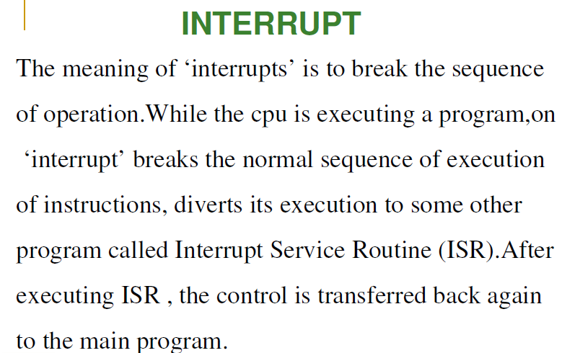
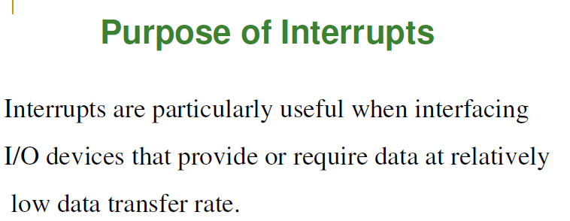

Slide 3
INT- interrupt program execution
It decrements the sp by 2 and pushes the flag registers on the stack.
Decrement the sp by 2 and push the content of CS onto the stack.
Decrement the sp by 2 and push the offset of the next instruction after the INT number instruction on the stack.
Get a new value for IP from an absolute memory address of 4 times the type specified in the instruction. For an INT 8 instruction, for example, the new IP will be read from address 00020h.
Get a new value for CS from an absolute memory address of 4 times the type specified in the instruction plus 2. For an INT 8 instruction, for example, the new value of CS will be read from address 00022h.
Reset both IF and TF. Other flags are not affected.

Slide 4
IRET-Interrupt return
-used at the end of the interrupt service procedure to return execution to the interrupt program.
INTO- interrupt on overflow
Decrement the SP by 2 and push the flags onto the stack.
Decrement the SP by 2 and push CS onto the stack.
Decrement the SP by 2 and push the offset of the next instruction after the INTO instruction onto the stack.
Reset TF and IF. Other flags are not affected. To do the call , the 8086 will read a new value for IP from address 00010H and a new value of CS from address 00012H.

Slide 5
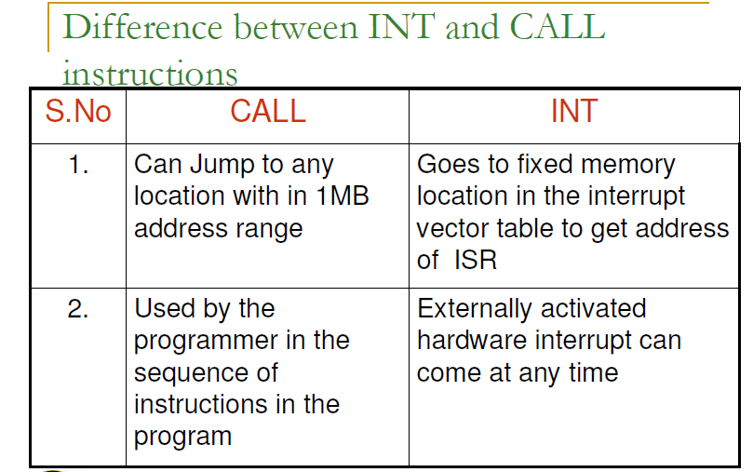

Slide 6
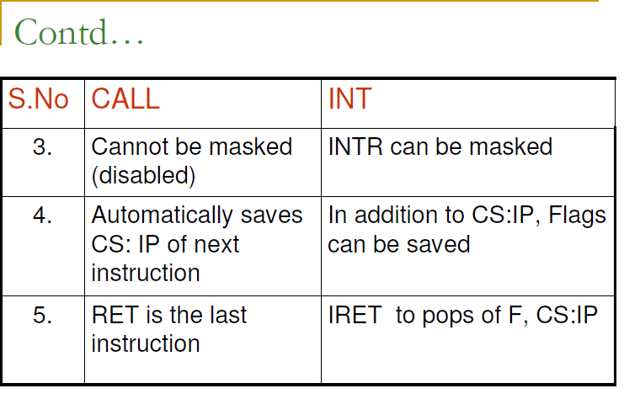

Slide 7
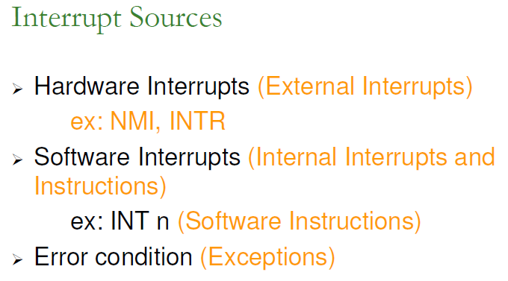
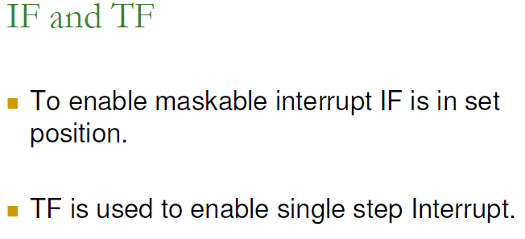

Slide 8
Sequence of events
It decrements the sp by 2 and pushes the flag registers on the stack.
It disables the 8086 INTR interrupt input by clearing the IF in the flag register
It resets the TF in the flag register
It decrements the SP by 2 and pushes the current CS register contents on the stack.
It decrements the SP again by 2 and pushes the current IP contents on the stack.
It does an indirect far jump To the start of the procedure you wrote to respond to the interrupt.

Slide 9
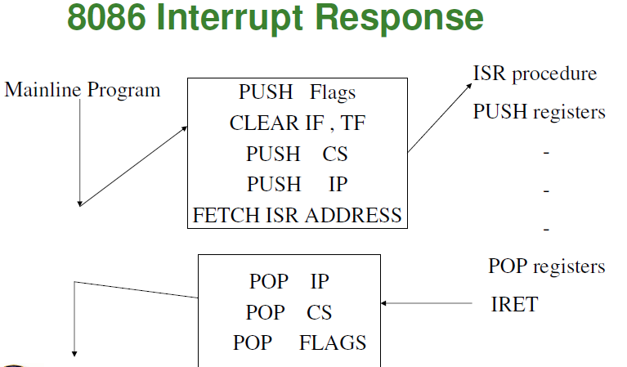

Slide 10
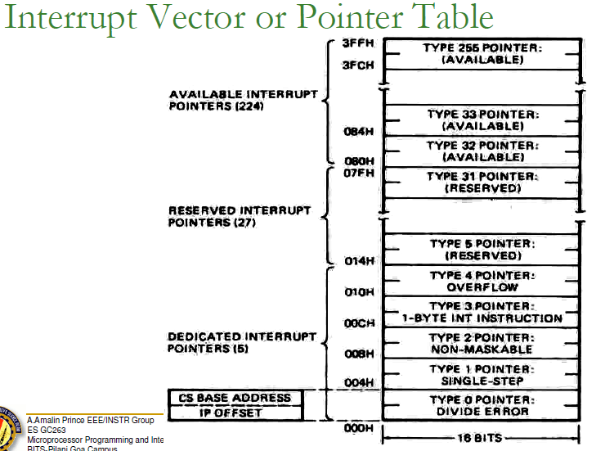

Slide 11
DIVIDE-BY-ZERO INTERRUPT-TYPE O
Whenever the quotient from a DIV or IDIV operation is too large to fit in the destination register
Divide a number by 0. the result is infinity, which is too large to fit in AX or AL.
SINGLE-STEP INTERRUPT-TYPE 1
TF=1
Execute one instruction and stop.
After execution of each instruction , 8086 automatically jumps to 00004h to fetch 4 bytes for CS:IP of the ISR(interrupt service routine)
The job of ISR is to dump the registers on to the screen.

Slide 12
NONMASKABLE INTERRUPT-TYPE 2
When ever the NMI pin of the 8086 is activated by a high signal (5v), the CPU jumps to physical memory location 00008 to fetch CS:IP of the ISR associated with NMI.
Example: save data incase of power failure
BREAKPOINT INTERRUPT-TYPE 3
A break point is used to examine the cpu and memory after the execution of a group of instruction.

Slide 13
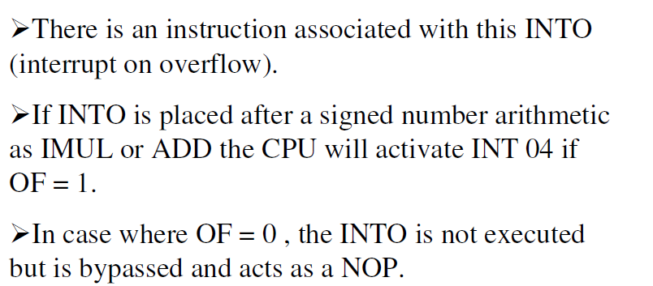
OVERFLOW INTERRUPT-TYPE 4

Slide 14
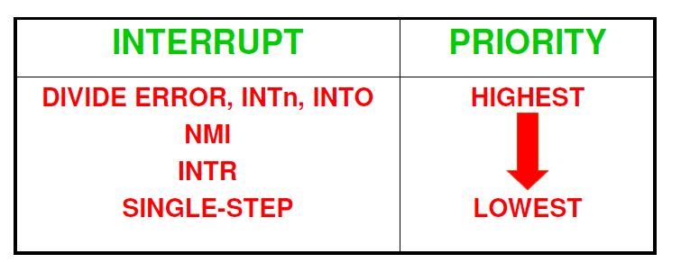
SOFTWARE INTERRUPTS-TYPES 0 THROUGH 255
INTR INTERRUPTS-TYPES 0 THROUGH 255
PRIORITY OF 8086 INTERRUPTS

Slide 15
